Slide 1

Data Analysis Essentials
Cornerstone Project — Second Review
Movie Rating Analysis System
Batch - 7
Presented by
M. Bhagya Sri (25B11AI720)
B. Jyostnavi (25B11AI081)
N. Swathi (26B21AI081)
K. Sri Bhargavi(26B21AI050)
Department of Artificial Intelligence & Machine Learning
Under esteemed guidance of:
Mr.B.Sai Venkata Ganesh
M.Tech, Assistant Professor (AIML)

Slide 2




PROPOSED SYSTEM
Existing System :
Movie data is stored in different formats.
Searching and analysing movie details manually takes time.
Comparing movies and TV shows is difficult.
Identifying popular genres and countries is not easy.
Data analysis requires more manual effort.
Proposed System :
Uses a single Netflix dataset.
Cleans and organizes movie information.
Analyses Movies and TV Shows separately.
Identifies popular countries and genres.
Studies content ratings and release-year trends.
Presents results using data visualizations.
SYSTEM WORKFLOW :
Data Loading
Data Cleaning
Preprocessing
Data Analysis
Visualization
Results
->
->
->
->
->

Slide 3
ABSTRACT
The Movie Rating Analysis System is a Python-based data analytics project developed using Pandas, NumPy and Matplotlib. It uses the Netflix Movies and TV Shows dataset containing 8,807 records and 12 columns. The system performs data loading, cleaning and preprocessing to handle missing values and duplicate records. It analyses different types of content, popular countries, genres, content ratings and release-year trends. Pandas and NumPy are used for data manipulation and statistical analysis, while Matplotlib is used to present the findings through charts. This project helps users understand the distribution and characteristics of movies and TV shows available on Netflix.
8,807
Total records
12
Dataset columns

Slide 4
PROBLEM STATEMENT
Nowadays, streaming platforms like Netflix provide a large collection of movies and TV shows belonging to different genres, countries, languages, and release years. Managing and analyzing such a huge amount of data manually is difficult and time-consuming.
The dataset may contain missing values, inconsistent information, and different types of records. Without proper data cleaning and analysis, it becomes difficult to understand the distribution of movies and TV shows, identify popular genres, study country-wise content availability, and observe changes in content over the years.
Therefore, the Movie Rating Analysis System is developed to analyze the Netflix Movies and TV Shows dataset using Python. By applying data preprocessing, Pandas, NumPy, and data visualization techniques, the system extracts meaningful information and presents useful insights in an understandable format.

Slide 5
OBJECTIVES
To collect and load the Netflix Movies and TV Shows dataset.
To understand the structure, size, and attributes of the dataset.
To identify and handle missing and duplicate values.
To perform data cleaning and preprocessing.
To analyze the distribution of movies and TV shows.
To study genre-wise and country-wise content distribution.
To analyze content classifications and release-year trends.
To represent the analysis results using suitable charts and visualizations.
To generate meaningful insights from the dataset.

Slide 6
TOOLS & TECHNOLOGIES
1. Programming Language
Python – Used for data processing and analysis.
2. Libraries
Pandas – Used for data loading, cleaning, and manipulation.
NumPy – Used for numerical operations and calculations.
Matplotlib – Used for creating graphs and visualizations.
3. Dataset
Netflix Movies and TV Shows Dataset (netflix_titles.csv).
Contains information about movies, TV shows, genres, countries, ratings, and release years.
4. Development Platform
Google Colab / Jupyter Notebook – Mention the platform actually used for project implementation.
5. Presentation Tool
Microsoft PowerPoint – Used to prepare project presentation slides.

Slide 7
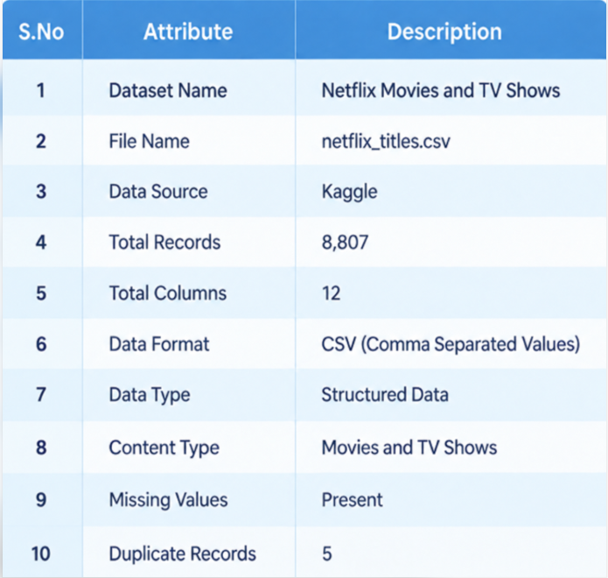
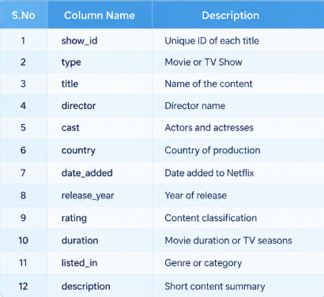
DATASET DETAILS – BEFORE CLEANING
DATASET SUMMARY:
DATASET ATTRIBUTE:

Slide 8
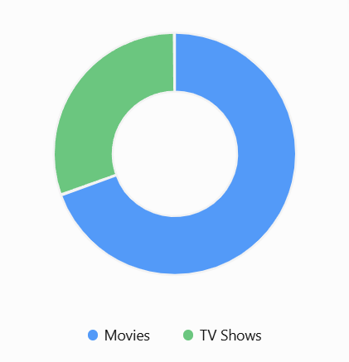
CLEANING,MISSING VAULES & DUPLICATE VALUES
CHECK | BEFORE CLEANING | AFTER CLEANING
Rows × Columns | 8,807 × 12 | 8,807 × 12
Duplicate rows | 5 found | 0
Missing values | 4,314 | 0
Columns | 12 | 12
MISSING VALUES :
Total 4,314 missing values were identified.
Missing values were handled using fillna().
Suitable replacement values such as Unknown were used.
No rows were removed for missing values.
DUPLICATE RECORDS :
5 completely duplicated rows were identified.
drop_duplicates() was used to remove duplicate records.
After cleaning, 0 duplicate rows remained.

Slide 9
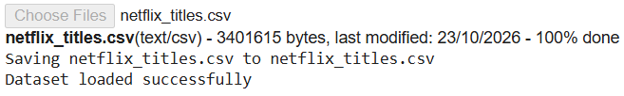
DATA LOADING
#IMPORT LIBRARIES
import pandas as pd
import numpy as np
#DATA LOADING
from google.colab import files
uploaded = files.upload()
file_name = list(uploaded.keys())[0]
df = pd.read_csv(file_name)
print("Dataset loaded successfully")
CODE :
OUTPUT :
The dataset is uploaded directly into Google Colab and loaded into a Pandas DataFrame. The DataFrame df is used for further exploration, cleaning, preprocessing, and analysis.
EXPLANATION :

Slide 10

DATA UNDERSTANDING
# Data Understanding
print("Number of Rows:", df.shape[0])
print("Number of Columns:", df.shape[1])
print("\nColumn Names:")
print(df.columns.tolist())
CODE :
OUTPUT :
Data understanding helps us identify the size and structure of the Netflix dataset before performing cleaning and analysis.
EXPLANATION :

Slide 11
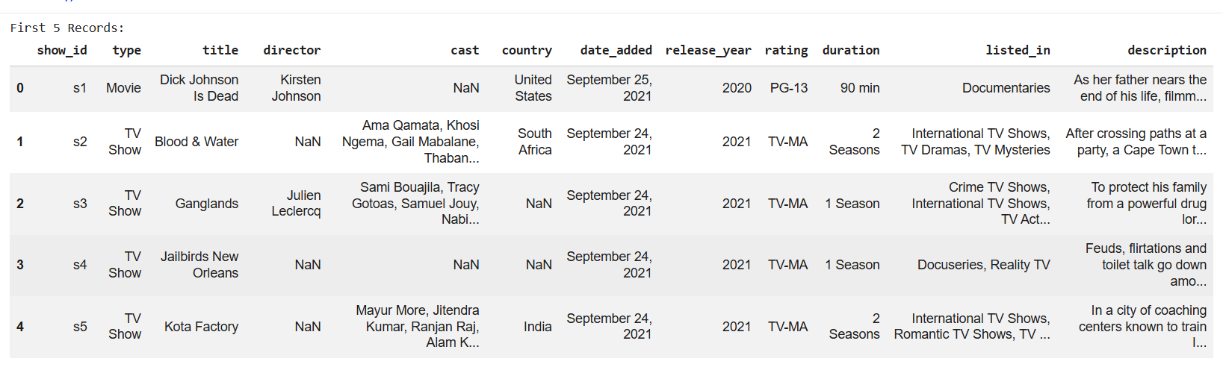
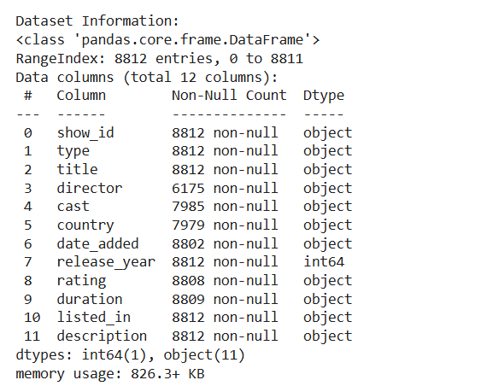
DATA INSPECTION
# Data Inspection
print("First 5 Records:")
display(df.head())
print("\nDataset Information:")
df.info()
OPERATIONS:
head() → displays the first 5 records
info() → shows column names, data types, and non-null values
CODE :
OUTPUT :

Slide 12
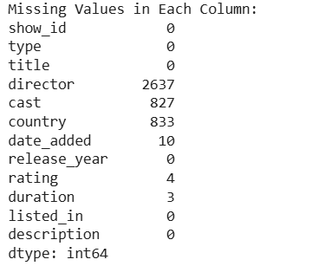
MISSING VALUE ANALYSIS
# Missing Value Analysis
missing_values = df.isnull().sum()
print("Missing Values in Each Column:")
print(missing_values)
IMPORTANT FINDINGS:
Total missing values: 4,314
CODE :
OUTPUT :
Missing values were identified before cleaning so that they could be handled appropriately during the data-cleaning stage.
EXPLANATION :

Slide 13

DUPLICATE VALUE ANALYSIS
# Duplicate Value Analysis
duplicate_count = df.duplicated().sum()
print("Number of Duplicate Rows:", duplicate_count)
CODE :
OUTPUT :
Five completely duplicated records were identified in the dataset. These duplicate rows were removed before further analysis.
EXPLANATION :

Slide 14


DATA CLEANING
# Remove Duplicate Rows
df = df.drop_duplicates()
print("Duplicate rows removed successfully")
print("Number of Duplicate Rows:", df.duplicated().sum())
print("Updated Dataset Shape:", df.shape)
#Handle Missing Values
df['director'] = df['director'].fillna('Unknown')
df['cast'] = df['cast'].fillna('Unknown')
df['country'] = df['country'].fillna('Unknown')
df['date_added’] =df['date_added'].fillna('Unknown')
df['rating'] = df['rating'].fillna('Unknown')
df['duration'] = df['duration'].fillna('Unknown')
print("Missing values handled successfully")
print("\nMissing Values After Cleaning:")
print(df.isnull().sum().sum())
CODE :
OUTPUT :
Duplicate rows removed: 5
Final row count: 8,807
Missing values were handled using "Unknown".
RESULT :

Slide 15
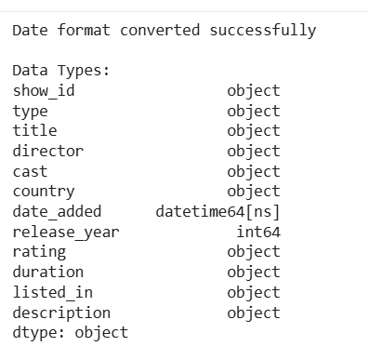
DATA PREPROCESSING
# Data Preprocessing
df['date_added'] = pd.to_datetime(
df['date_added'],
errors='coerce’)
print("Date format converted successfully")
print("\nData Types:")
print(df.dtypes)
CODE :
OUTPUT :
The date_added column was converted into a proper date format. This makes the column suitable for future date-based analysis.
EXPLANATION :

Slide 16
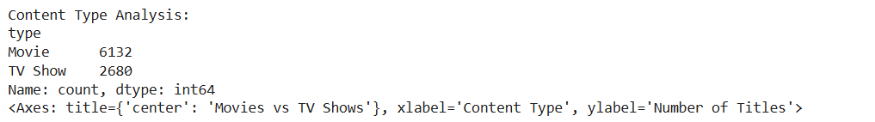
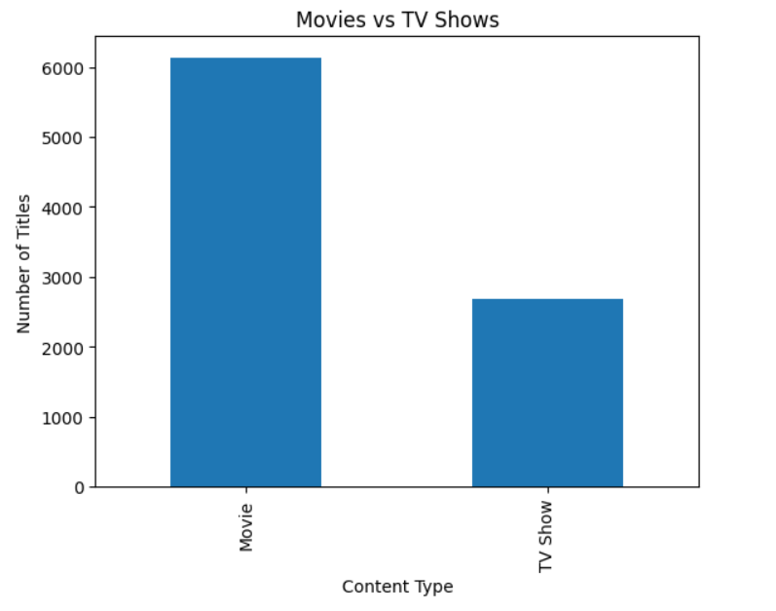
DATA ANALYSIS
# Data Analysis - Movies vs TV Shows
type_count = df['type'].value_counts()
print("Content Type Analysis:")
print(type_count)
type_count.plot( kind='bar', title='Movies vs TV Shows', xlabel='Content Type', ylabel='Number of Titles' )
CODE :
OUTPUT :

Slide 17
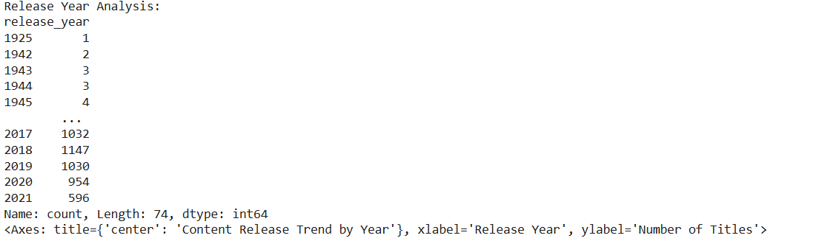
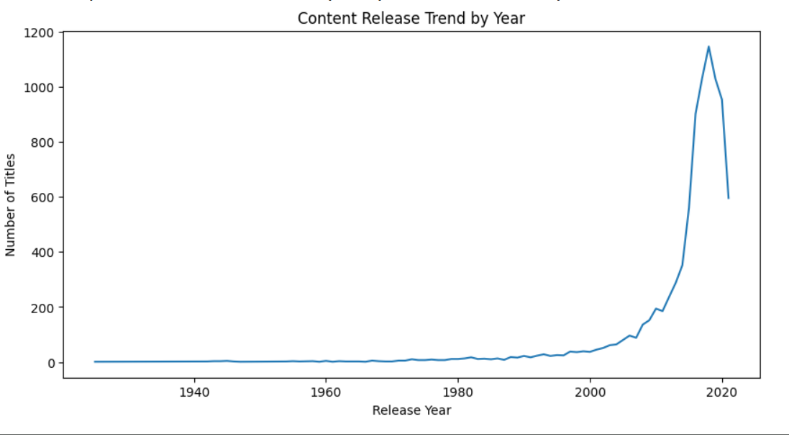
RELEASE YEAR ANALYSIS
# Data Analysis - Release Year Analysis
release_year_count = df['release_year'].value_counts().sort_index()
print("Release Year Analysis:")
print(release_year_count)
release_year_count.plot(
kind='line',
title='Content Release Trend by Year',
xlabel='Release Year',
ylabel='Number of Titles',
figsize=(10, 5))
CODE :
OUTPUT :

Slide 18
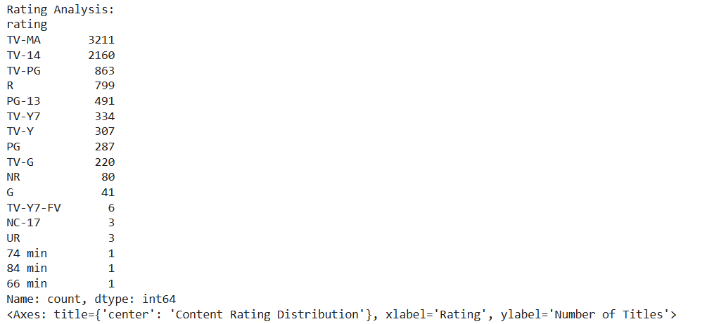
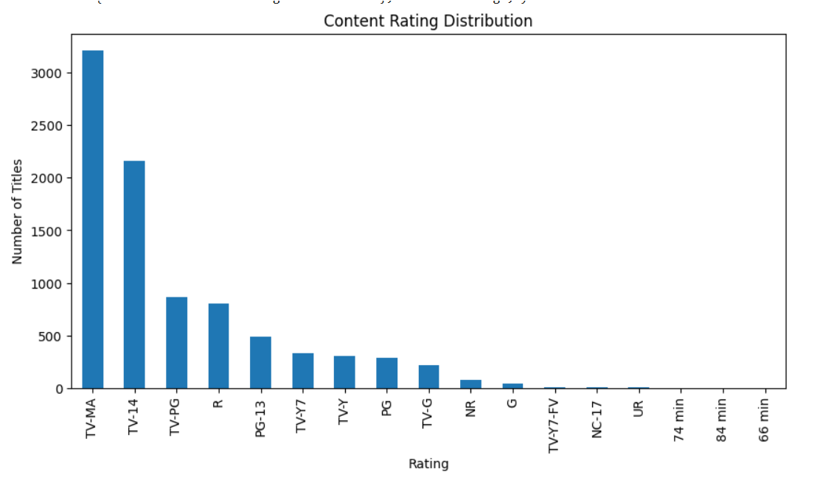
RATING ANALYSIS
# Data Analysis - Rating Analysis
rating_count = df['rating'].value_counts()
print("Rating Analysis:")
print(rating_count)
rating_count.plot(
kind='bar',
title='Content Rating Distribution',
xlabel='Rating',
ylabel='Number of Titles',
figsize=(10, 5))
CODE :
OUTPUT :

Slide 19
EXPECTED Vs ACTUAL OUTPUTS
OUTPUT | EXPECTED RESULT | ACTUAL RESULT
DATASET SHAPE | 8,807 × 12 | 8,807 × 12
MISSING VALUES | IDENTIFIED AND HANDLED | HANDLED
DUPLICATE RECORDS | NO DUPLICATES | 0
CONTENT TYPES | 2 CATEGORIES | MOVIES & TV SHOWS
COUNTRY ANALYSIS | TOP 10 COUNTRIES | GENERATED
GENRE ANALYSIS | TOP 10 GENRES | GENERATED
RATING ANALYSIS | RATING DISTRIBUTION | GENERATED
RELEASE YEAR | YEAR-WISE ANALYSIS | GENERATED

Slide 20
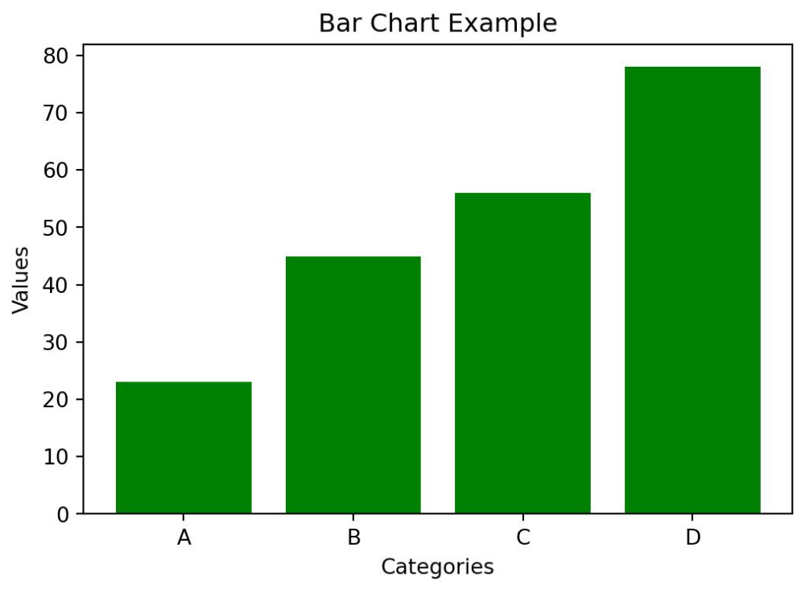
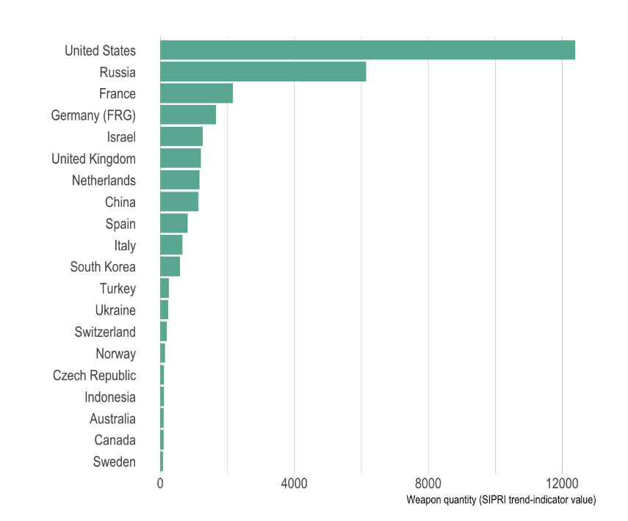
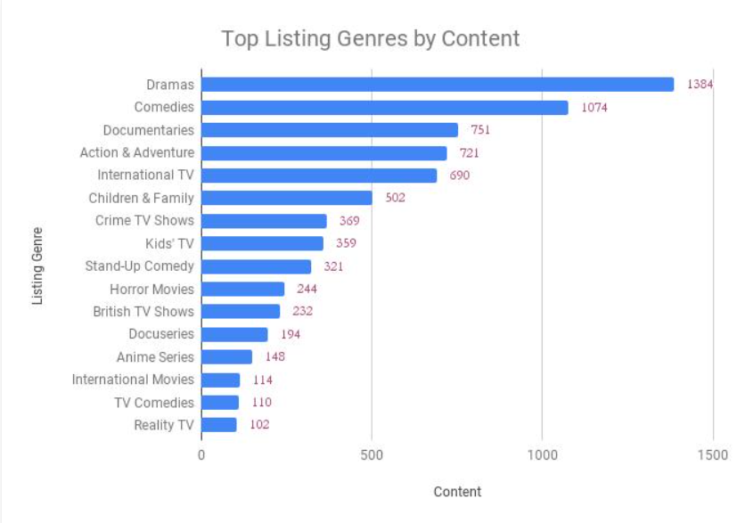
DATA VISUALIZATION
Bar Chart – Movies vs TV Shows
Compares the number of movies and TV shows.
Horizontal Bar Chart – Countries
Displays the top 10 countries.
Bar Chart – Genres
Displays the most common genres.

Slide 21
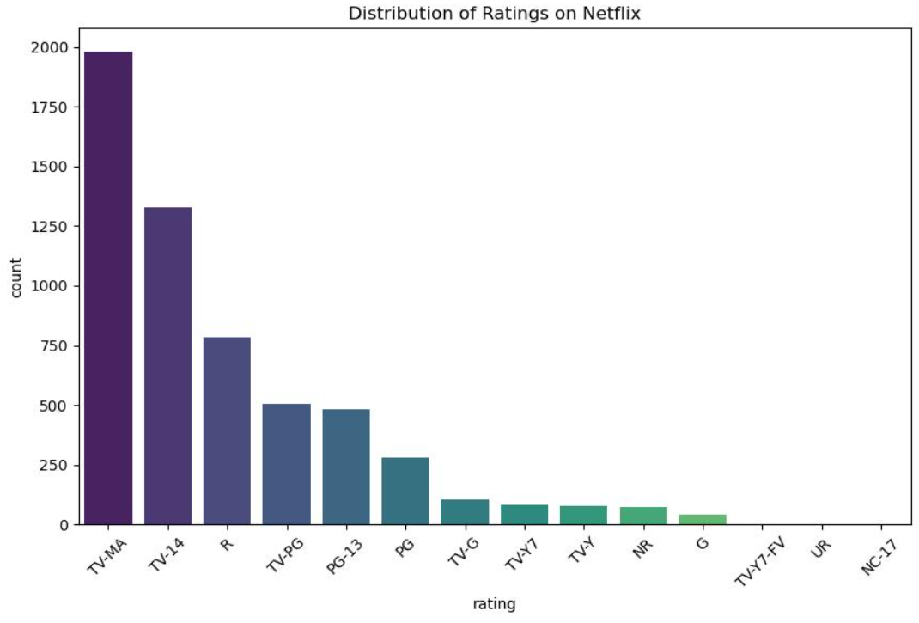
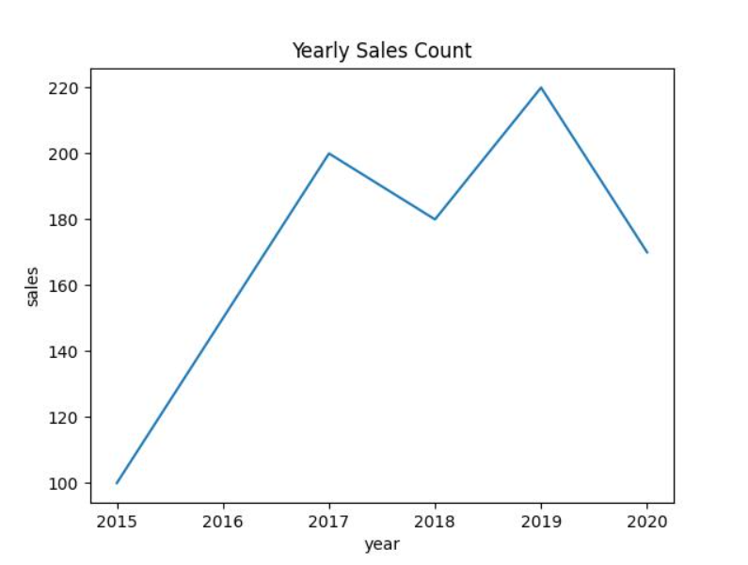
DATA VISUALIZATION
Bar Chart – Content Ratings
Shows the distribution of content classifications.
Line Chart – Release Years
Shows the year-wise content trend.

Slide 22
CONCLUSION & FUTURE SCOPE
Conclusion :
Successfully analysed the Netflix Movies and TV Shows dataset.
Performed data cleaning and preprocessing.
Identified missing values and duplicate records.
Analysed content types, countries, genres and ratings.
Studied release-year trends using Python libraries.
Presented the results through data visualizations.
Future Scope:
Add audience movie ratings and review data.
Perform sentiment analysis on user reviews.
Develop an interactive movie recommendation system.
Create a web-based dashboard.
Analyse movie popularity using additional datasets.

Slide 23


